Slide 1
Patient PulseHub
Submitted by : Aganay Sambyal Submitted to : Dr .Diksha Hooda
211175
Vaibhav Gupta
211183

Slide 2
TABLE OF CONTENTS
01
02
03
Introduction
Features
About the features
04
05
Technologies Used
Conclusion

Slide 3
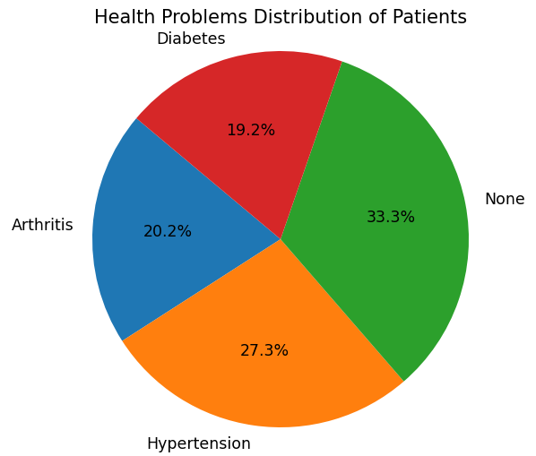
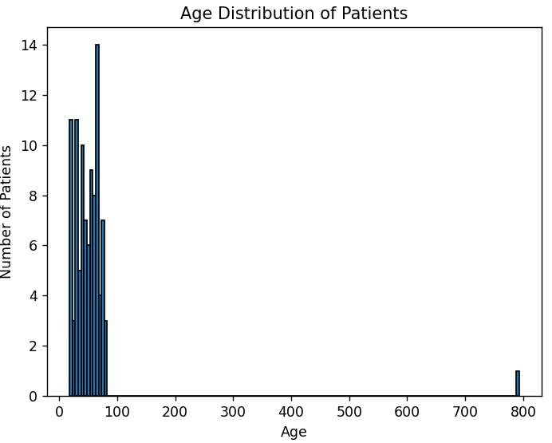
INTRODUCTION
Healthcare facilities require efficient and organized systems to manage patient records effectively. The Patient PulseHub is a Python-based solution designed to streamline the process of updating, and retrieving patient information. This project aims to provide healthcare professionals for managing patient records, offering features such as data entry, search functionality, and data visualization.

Slide 4
KEY FEATURES
01 : ADDING NEW PATIENTS
02 : SEARCHING PATIENTS
03 : DISPLAYING ALL PATIENTS
04 : UPDATING PATIENT INFORMATION
05: DELETING PATIENT RECORDS
06: SEARCHING PATIENTS BY AGE RANGE
07: PLOTTING AGE DISTRIBUTION
08: PLOTTING HEALTH PROBLEM
DISTRIBUTION
09: QUIT

Slide 5
ABOUT THE FEATURES

Slide 6
01
ADDING A NEW PATIENT
Capture essential patient details, including name, address, phone number, age, and health problems.
Ensure data consistency with a unique Patient ID for each record.

Slide 7
02
SEARCHING PATIENTS
Retrieve patient information based on the unique PatientID.
Display a comprehensive list of all patients in the system.

Slide 8
03
UPDATING PATIENT INFORMATION
Modify existing patient records with updated information.
Enhance data accuracy by providing a mechanism for information updates.

Slide 9
04
DELETING PATIENT RECORDS
Remove patient records when necessary, maintaining an accurate and up-to-date database.

Slide 10
05
SEARCHING PATIENTS BY AGE RANGE
Utilize a search feature to filter and display patients within a specified age range.

Slide 11
06
PLOTTING HEALTH PROBLEM DISTRIBUTION
DATA VISUALIZATION
Plot the age distribution of patients to gain insights into the age demographics.
Visualize the distribution of health problems among patients.

Slide 12
TECHNOLOGIES USED
Python:
Core programming language used for developing the system.
CSV (Comma-Separated Values):
Data storage format for maintaining patient records.
Matplotlib:
Python library used for creating visualizations, such as histograms and pie charts.

Slide 13

CONCLUSIONS
The Patient Records Management System provides a reliable and efficient solution for healthcare professionals to manage patient information. With features for data entry, retrieval, and visualization, the system enhances the overall workflow, contributing to better patient care and management.

Slide 14
THANK YOU

